Slide 1

Shark Boy & Lava Girl
By: Romy, Ahmad, Chika and Sherif

Slide 2

Project Overview

Slide 3

Project Overview
We received a dataset that included a lot of information about every documented shark attack since the 1800s, so we took the following approach.
Brainstormed initial theories on dataset.
Narrowed our theories down to 2 core hypothesis.
Proceeded with Data cleaning techniques
Breaking down each hypothesis into separated analysis.
Proved/disproved our hypothesis.
We decided on the following 2 hypothesis:
Hypothesis 1: Provoked shark attacks are more fatal than unprovoked.
Hypothesis 2: Great white sharks are the most fatal species
Notes:
We received a dataset that included a lot of information about every documented shark attack since the 1800s, so we took the following approach.
We brainstormed our initial thoughts and theories about the dataset through basic pandas functions, to gain more insight.
We narrowed our theories down to 2 core hypothesis.
We agreed that in order to begin working on our hypothesis, we first had to clean the DF as much as possible.
This involved; renaming column names, dropping columns we didn’t find useful, cleaning out some unique values & formats in columns, filling/dropping null values and then finally clearing duplicates.
After completing all of this we began working on our 2 hypothesis, which were…
Hypothesis 1: Provoked shark attacks are more fatal than unprovoked.
Hypothesis 2: Great white sharks are the most fatal species

Slide 4

Data Cleaning Techniques
Formatting columns (lowercase + no spaces)
Dropping irrelevant columns
Cleaning unique values in certain columns
Dealing with nulls per column (different strategy for each)
Dropped duplicates
Notes:
For age column we filled with the mean of age
For name we used John & Jane Doe
etc..

Slide 5

Data Wrangling and Cleaning Challenges
Challenge 1: Cleaning name column with John & Jane Does
Solution: Using loc to filter M & F genders to then swap name values.
Challenge 2: Cleaning date column to all have matching formats.
Solution: Seeked help from Felipe, then deep dive into understanding the regex used to apply for our file of code.

Slide 6

Exploratory Data Analysis Methods
1- Summary statistics
Applied the mean on the age column to fill nulls
Used counts on ‘type’, ‘fatality’ and ‘species’ to test hypothesis
2- Visualizations
Stacked bar graph for Hypothesis 1
Horizontal bar graph for Hypothesis 2
3- Relationship between variables
Grouping fatality outcomes with types of attacks
Grouping fatality outcomes with species of sharks

Slide 7

Major Obstacles Encountered
Obstacle 1: Visualising the data in clear graphs.
Solution: Dropping values that are not related to our hypothesis to keep the graphs concise.
Learning: Bar graphs can be a very powerful tool to display data.
Obstacle 2: Cleaning species column
Solution: Creating a fuzzy matching function to find best matches and a regular function for exact matches.
Learning: Regex may not always be the best solution.

Slide 8
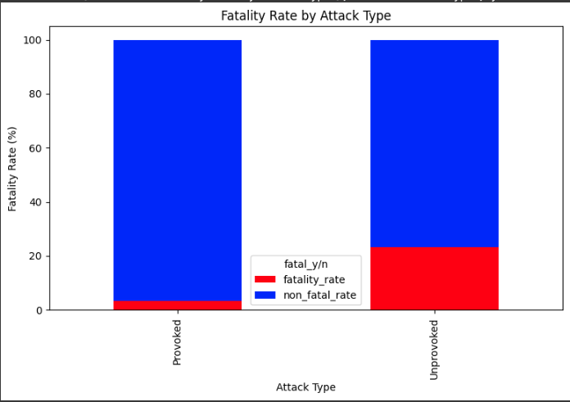
Hypothesis Evaluation
Hypothesis 1 : Provoked shark attacks are more fatal than unprovoked.

Slide 9
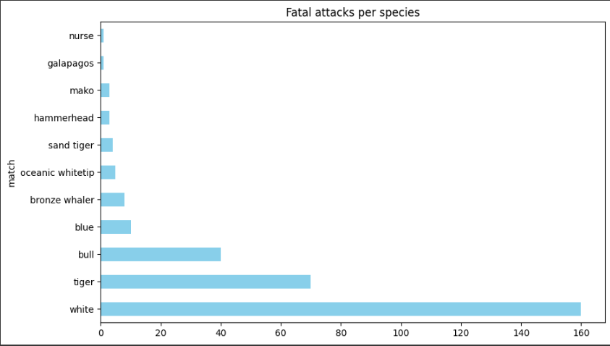
Hypothesis Evaluation
Hypothesis 2 : Great white sharks are the most fatal species

Slide 10

Conclusion
Hypothesis 1: Disproved.
In the end, unprovoked shark attacks were much more deadly than provoked.
Our theory is provoked attacks likely have more prepared victims than unprovoked.
Hypothesis 2: Proved.
Great whites are known to be one of the most dangerous species, and it turned out to be correct.
FYI: Jaws was right.

Slide 11

By: Romy, Ahmad, Chika and Sherif
Project Link

